Slide 2
Front-end development for back-end developers
#webdev
Frank Folsche & Steef Burghouts

Slide 3

About us
Frank Folsche
Software engineer at Luminis Arnhem
Full-Stack .Net developer
Frank.folsche@luminis.eu
Steef Burghouts
Software engineer at Luminis Arnhem
Java developer
steef.burghouts@luminis.eu

Slide 4
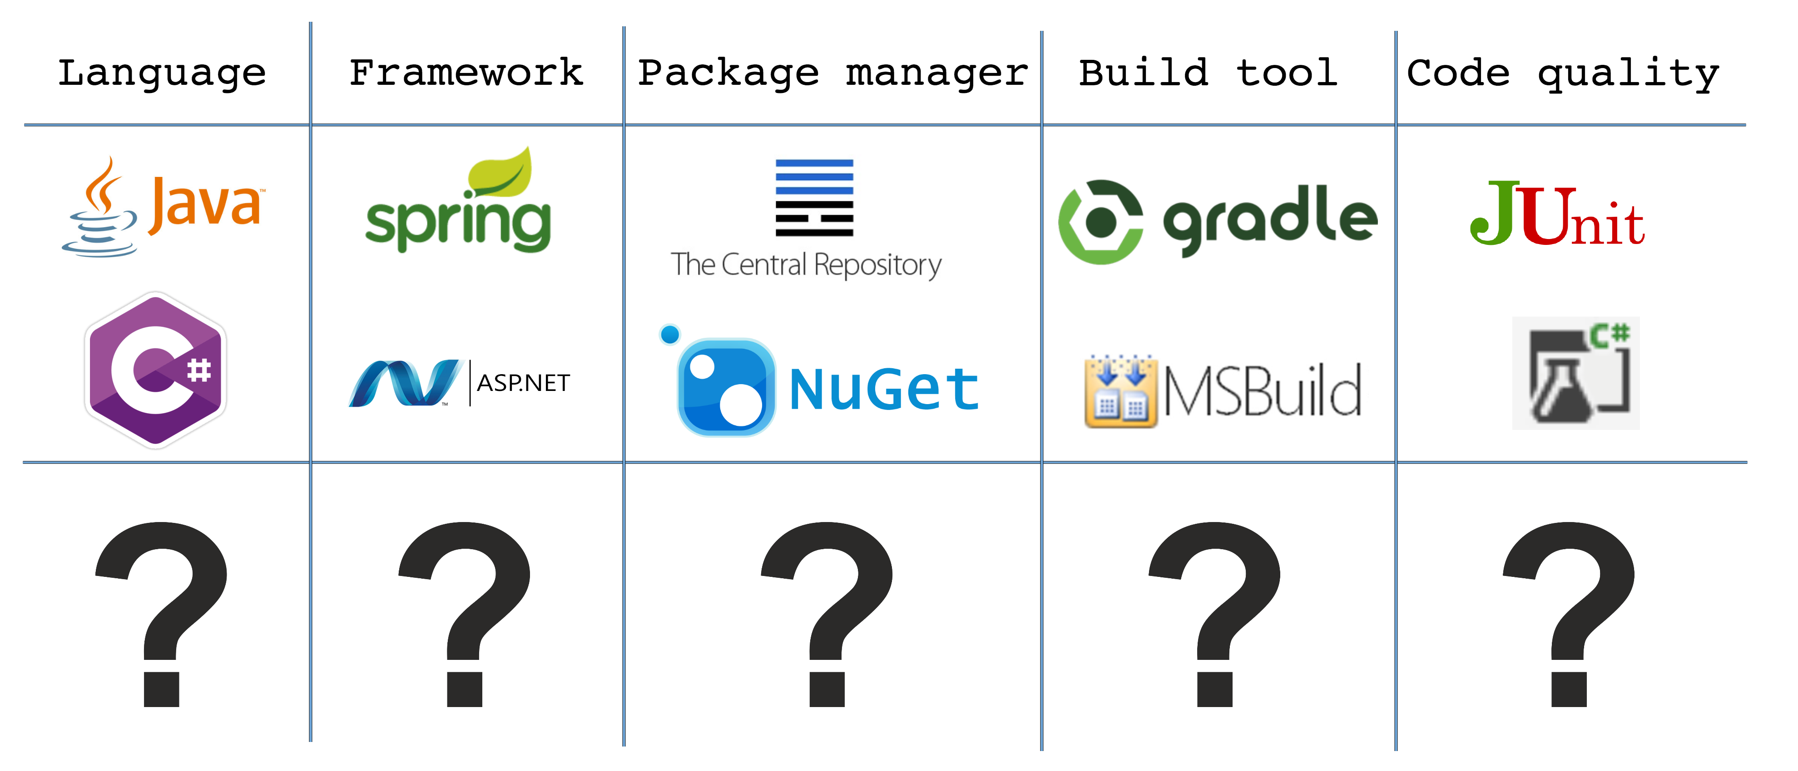
Notes:
Feest van herkenning voor back-end
Stap voor stap de vraagtekens vervangen door front-end technieken

Slide 5
"Javascript makes me want to flip the table and say ”**** this shit"
but I can never be sure what "this" refers to
Ölbaum

Slide 6
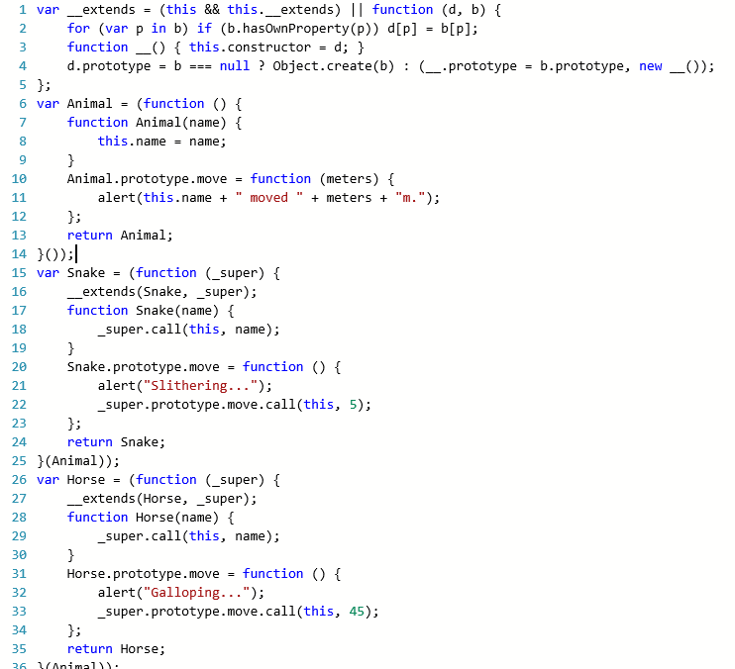
Language
I don’t like javascript…
Javascript scopes
Dynamic typing
No modularity
False/Null/undefined/zero/NaN
var a = 1;
function four() {
if (true) {
var a = 4;
}
alert(a); // alerts 4
}
But we need it…
Only scripting language supported by all browsers
Huge amount of libraries
Notes:
Javascript global variables
Strange (sometimes) unpredictable behaviour
No modularity – no information hiding, interfaces between components
(Geen OO paradigma) - immediately invoked function expression (IIFE)
IE support nog vbscript, chromium dart
Javascript scaled helemaal niet
"Javascript makes me want to flip the table and say ”**** this shit", but i can never be sure what "this" refers to"
Dynamic typing makes a language very flexible, but makes it hard for development
We’d like to know what properties an object in another file contains, what an invalid parameter to a function may be, or let us know when we use a variable in an improper scope. ES5 makes these things difficult on developers and on tooling.

Slide 7



Language
Available languages
And 147 other languages that compile to Javascript…
Notes:
https://github.com/jashkenas/coffeescript/wiki/List-of-languages-that-compile-to-JS
Typescript: Microsoft Anders Hejlsberg OO subset Javascript
Coffeescript: Lijkt op ruby, python en haskall; voegt static typing toe
Babel: Javascript compiler for ECMAScript 2015

Slide 8
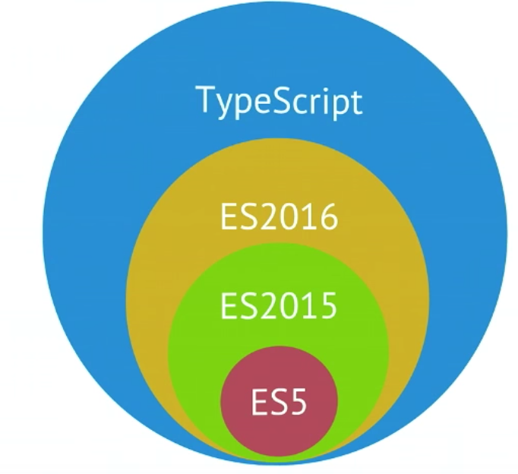

Language Typescript – superset of javascript
Superset Javascript
Optionally typed
Object Oriented
Module system
IDE's support us with suggestions
Supports new ECMAScript features
Notes:
Superset Javascript builds on top of ES5 and includes features from ES6 and ES7 -> compiles to ES3/ES5/ES6 javascript -> do not need any special runtime

Slide 9
Language Typescript – superset of javascript
Valid Javascript is valid Typescript
Use of Javascript ecosystem
Notes:
TSC is de typescript compile. De compiler doet niks met de javascript. Sterker nog, hij geeft warnings als er problemen zijn in de code

Slide 10
Language Typescript – optionally typed
A bit of Javascript...
A bit of Typescript…
var count = 123; count.toUpperCase();
var count = 123;
count.toUpperCase();
var count: string = 123; count.toUpperCase();
Compile-time:
Property 'toUpperCase' does
not exist on type 'number'.
Runtime:
count.toUpperCase is not a function
Compile-time:
Type 'number' is not assignable to type 'string'.
Compile-time:
Type 'number' is not assignable to type 'string'.
Compile-time:
Type 'number' is not assignable to type 'string'.
Notes:
type inference
Detect errors earlier in the proces

Slide 11
Language Typescript – Module system
Namespaces
Access identifiers
Information hiding
namespace People {
export class PeopleController {
public someVariable: string;
constructor() {
this.someVariable = "initial value";
}
public setSomeVariable() {
this.someVariable = "something";
}
}
}
let hans = new People.PeopleController();
Notes:
Namespaces -> put objects on a namespace instead of the global scope.
You can see a namespace as a namespace in .net
The namespace will be on the global scope and the objects can be obtained with using the specific namespace
+ Name collision of objects

Slide 12

Language Typescript – Demo
http://www.typescriptlang.org/Playground
Notes:
Typescript playground -> IDE for playing around in Typescript
Compiler is written in Javascript
Refactor “classic javascript” to typescript:
class Greeter {
constructor(public greeting: string) {}
public greet(): string {
return "hello " + this.greeting;
}
}
class SadGreeter extends Greeter {
public greet(): string {
return "bye " + this.greeting;
}
}
let greeter = new Greeter("world");

Slide 13
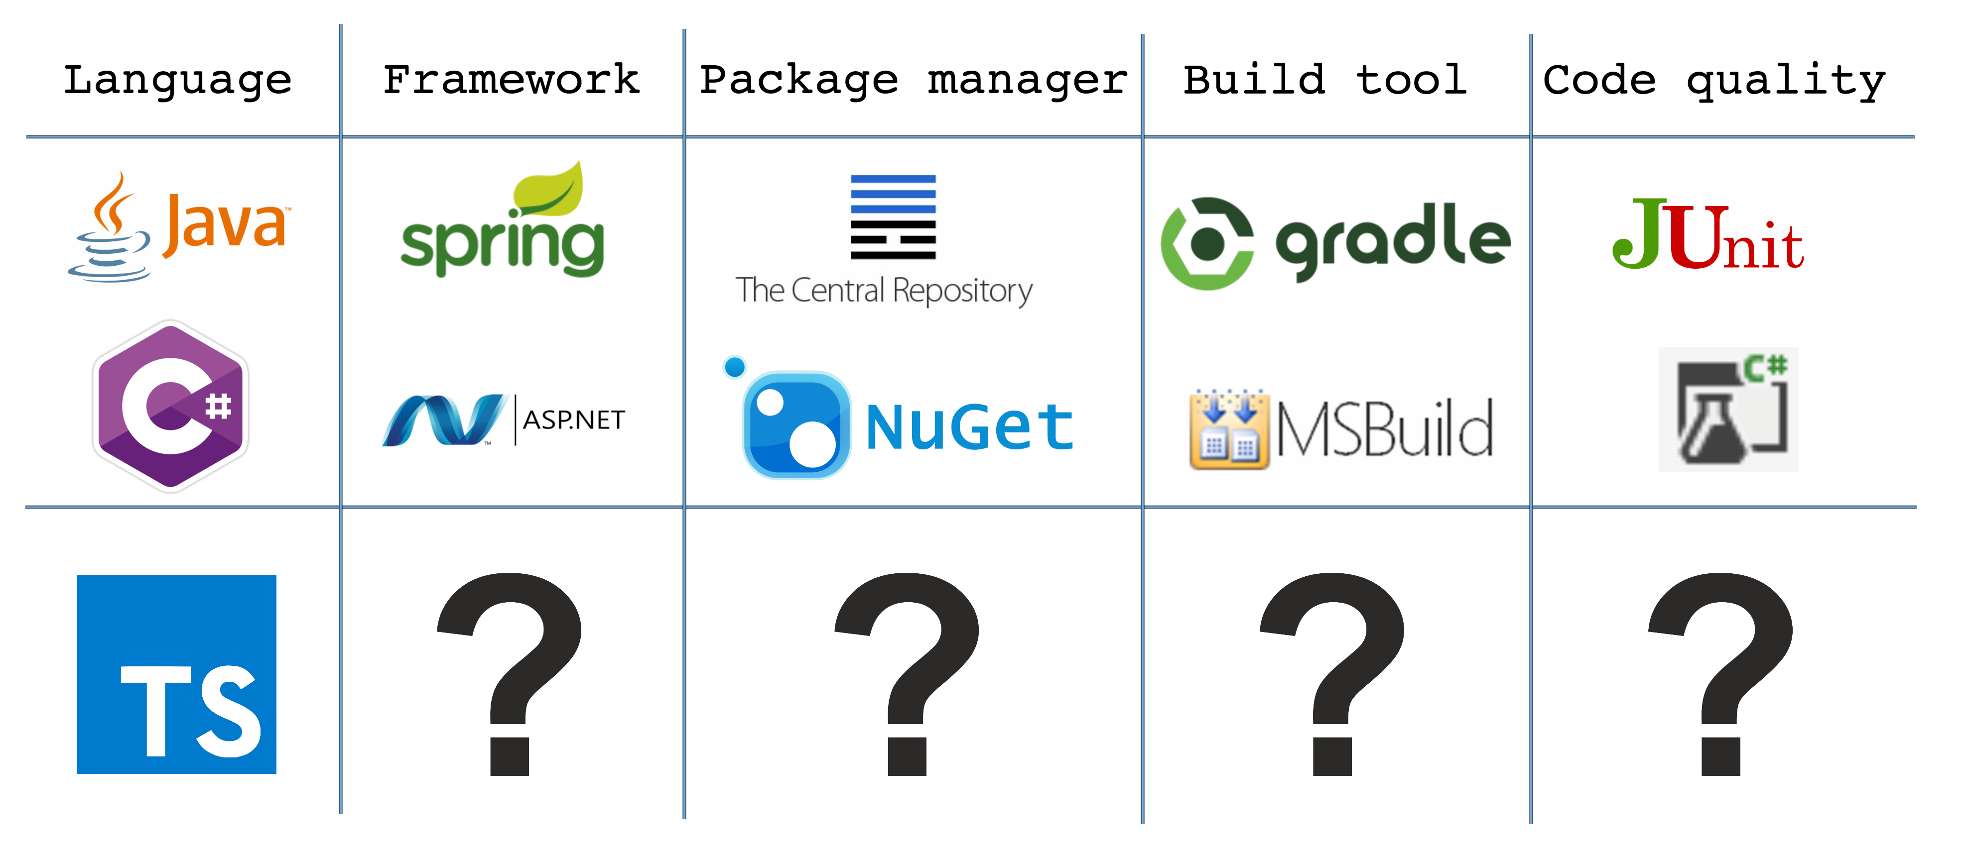

Slide 14
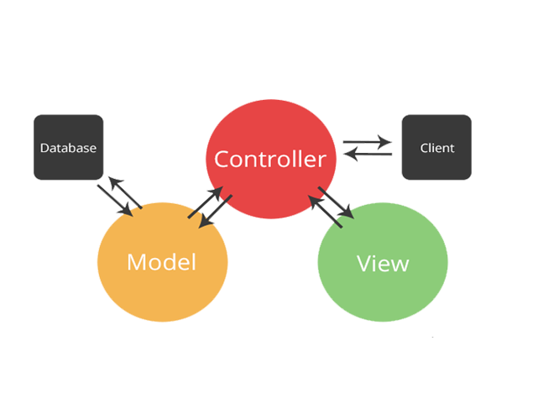
Framework Server side Web MVC framework
Notes:
Conventional MVC frameworks require to do a roundtrip to the server at every state change. Not very responsive and doesn’t create a fluid experience.

Slide 15

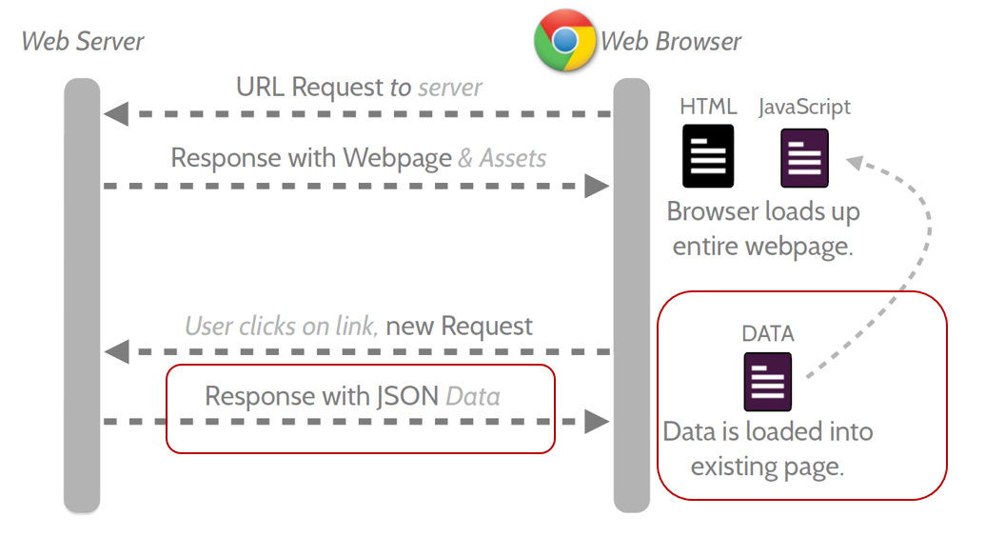
Framework SPA framework
Single Page Application is a web app in which the majority of interactions are handled on the client without the need to reach a server, with a goal of providing a more fluid user experience
Notes:
All the UI logic is executed on the client.
Everytime when our previous MVC application needed data, the application using the SPA framework needs the data as well. The diferent is that not a whole roundtrip is required, only the actual data needed.

Slide 16








Framework SPA framework
Notes:
Angular -> spinoff van google
Knockout -> MVVM client side code -> structure your code
EmberJS -> vergelijkbaar met angular -> jquery handlebars
Backbone.js > A JavaScript library that helps you structure your client-side code with Models, Collections, and Views. (Document cloud)
Meteor -> Full javascript app platform (built on node.js)
Ext js -> More focussing on enterprise apps

Slide 17
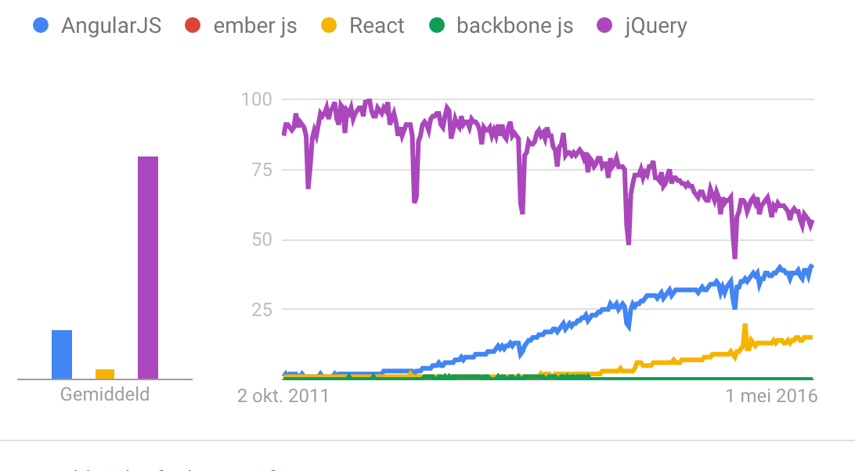
Framework SPA framework
Github stars
AngularJS: 52.350
Meteor: 35.400
Backbone: 25.500
EmberJS: 16.900
Knockout: 7.700
jQuery: 41.400
Notes:
jQuery = library, Angular = framework. Angular ships with jquery light
Do not compare frameworks based on arguments on popularity or github stars. Front-end frameworks are mainly open-source and you shouldn’t see them as competitors, but rather as collaborators. Angular looked how ember did his routing. Angular learned a lot from reacts

Slide 18
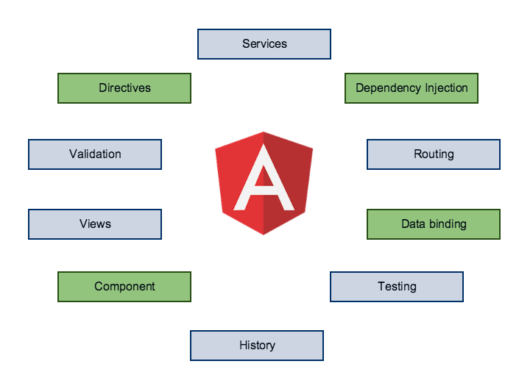
Framework Angular JS
AngularJS is a feature rich MVW Framework
Suitable for large web applications
Extends HTML
Two way data binding
Cross-browser compatible
Testable from the ground up
Notes:
Model-View-Whatever
MVC - MVVW – MVP
First MVC -> more going towards MVVM because of the refactoring op the $scope API. After many discussions the team declared it as MVW -> whatever suits you
IE 9 (2011) >
- It is a very good idea to decouple DOM manipulation from app logic. This dramatically improves the testability of the code.
- It is a really, really good idea to regard app testing as equal in importance to app writing. Testing difficulty is dramatically affected by the way the code is structured.
- It is an excellent idea to decouple the client side of an app from the server side. This allows development work to progress in parallel, and allows for reuse of both sides.
- It is very helpful indeed if the framework guides developers through the entire journey of building an app: From designing the UI, through writing the business logic, to testing.
It is always good to make common tasks trivial and difficult tasks possible.

Slide 19
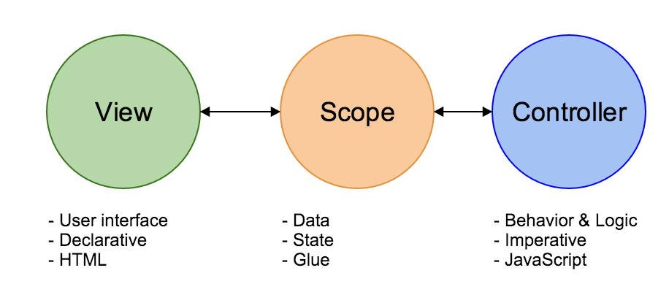
Framework Angular JS
Notes:
Like I said earlier, the framework consists of 3 important parts
Normally the controller is the first who handles user interaction, however in Angular it is the scope
View -> Views containing HTML and declarative
Scope -> glueing the view with the rest of the application code > two-way-databinding.
Declerative: state the what
Imperative: state the how

Slide 20
Framework Angular JS – directives
Directives are markers on a DOM element (such as an attribute, element name, comment or CSS class) that tell AngularJS to attach a specified behavior to that DOM element (e.g. via event listeners), or even to transform the DOM element and its children.
<table class="table table-striped">
<tr ng-repeat="talk in ctrl.talks">
<td> {{ talk.title }} </td>
</tr>
</table>
Notes:
Dingen die opvallen:
Extra elementen op DOM elementen
Presentatie logica naar html
De {{ }} syntax
De appModule -> SPA alle modules worden op die manier geladen
Combinatie typescript – angularJS
The way the Controller as syntax works (since AngularJS 1.2), is by binding the Controller to the current $scope

Slide 21

Framework Angular JS – Two way data binding
$scope is the glue for two way data binding!
namespace Talk {
export class TalkController {
public title: "Talks";
constructor() {}
}
}
<input type="text" ng-model=”talkController.title" />
<h1> {{talkController.title }} </h1>

Slide 22
Framework Angular JS – dependency injection
Module dependency
angular.module("techdays", ["talk"]);
Register module
Register service dependency
let talkModule: angular.IModule = angular.module("talk",[]);
talkModule.service("talkService", TalkService);
Inject service dependency
export class TalkController {
constructor(public talkService: TalkService){}
}
Notes:
Dingen die opvallen:
Inject van ui.router library
Creation of dependencies to the module
- Separate the process of creation and consumption of dependencies
- Let the consumer worry only about how to use the dependency, and leave the process of creation of the dependency to somebody else
- Allow concurrent/independent development of the dependency and the dependent entity, while only maintaing a known contract
Facilitate changing of the dependencies when needed
testing components much easier, because you can pass in a component's dependencies and stub or mock them as you wish.

Slide 23
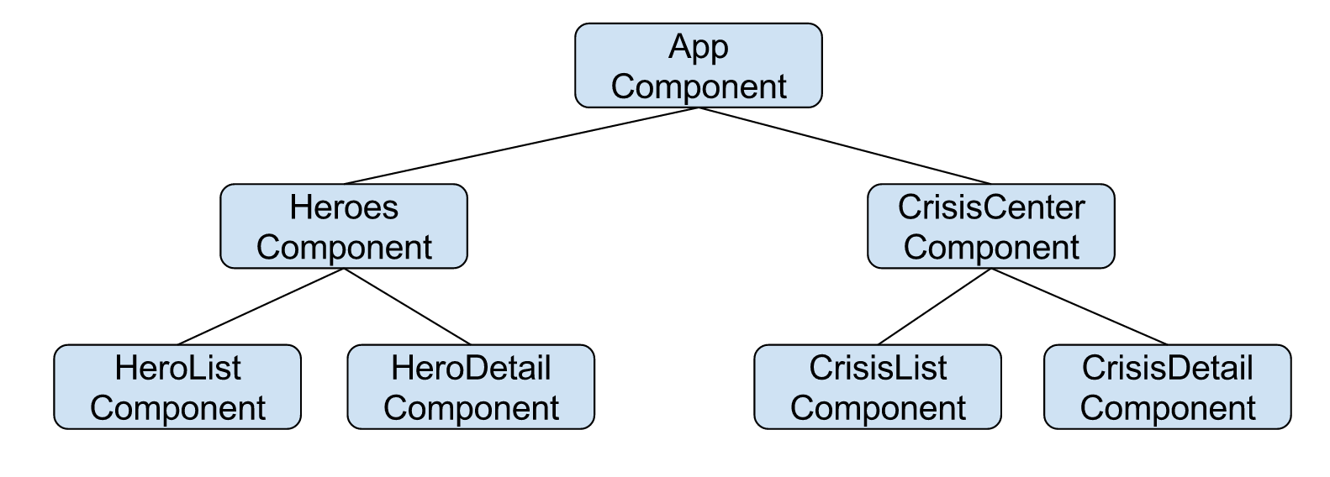
Framework Angular JS – components
Components only control their own View and Data:
Components have a well-defined public API - Inputs and Outputs
Components have a well-defined lifecycle
An application is a tree of components
Notes:
Component should never modify any data or DOM that is out of their own scope. (normally through scope inheritance and watches you can modify anything) practical but can lead to problems.
2. Different kind of binding: One way binding and two way binding: Best practice is to never change the property in the component scope as it will also change the parent scope.
3. Lifecycle hooks $onInit(), onchange, doCheck (called on each digest), onDestroy, postLink

Slide 24
Framework Angular JS – components
angular.module('heroApp').component('heroDetail', {
templateUrl: 'heroDetail.html',
controller: HeroDetailController,
bindings: {
hero: '<',
onDelete: '&',
onUpdate: '&'
}
});
Notes:
Isolated components that are composable, reusable and should work with other pieces
- dAta flow to the children. Children are responsible for propogating events up to the parent

Slide 25
Language AngularJS – Demo
Notes:
public getTalks() {
this.talkService.getAllTalks().then((talks: Talk[]) => { t
his.talks = talks;
});
}
public talks: Talk[];
Public title: string;
this.getTalks();
This.title = “Talks”
<h2>{{ ctrl.title }}</h2>
<table class="table table-striped">
<tr ng-repeat="talk in ctrl.talks">
<td> {{ talk.title }} <td>
</tr>
</table>

Slide 26
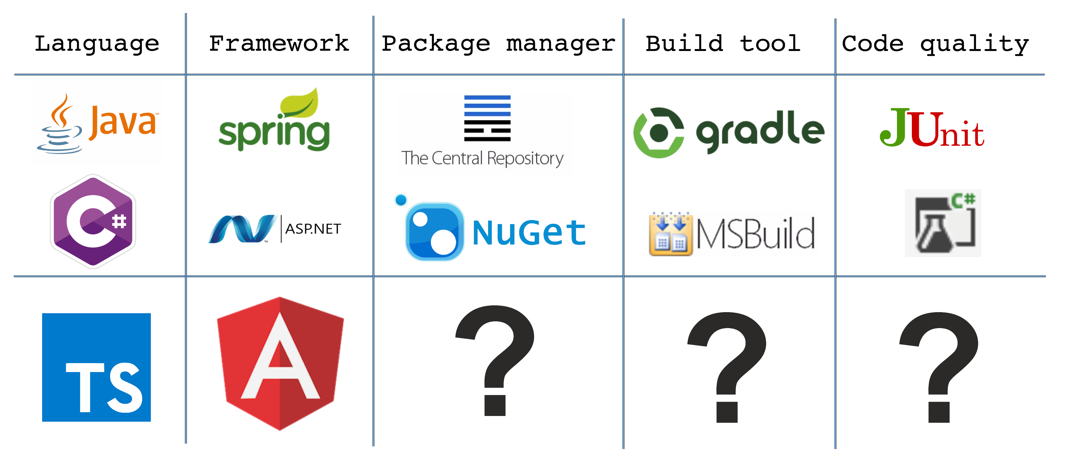
Language Typescript – superset of javascript
Valid Javascript is valid Typescript
Use of Javascript ecosystem

Slide 27




Managing packages Why reinvent the wheel?
NuGet
Maven Central
Npm
Bower

Slide 28
Managing packages Bower
Bower Front-end dependencies
Hosted at
Github
Bower Registery
Subversion
Local file path
Single files or a zip
{
"name": "Devcon Webdev",
"version": "0.1.1",
"dependencies": {
"angular": "1.4.8",
"angular-ui-router": "0.2.15",
"bootstrap": "^3.3.6“
},
"devDependencies": {
"angular-mocks": "^1.5.0"
}
}
init
install
uninstall
update
bower.json

Slide 29
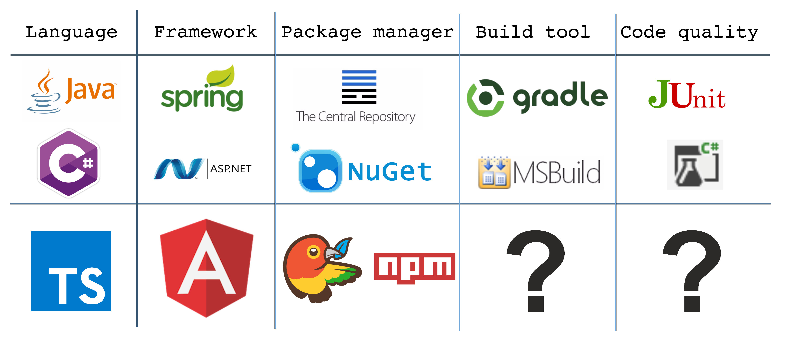
Bower Front-end dependencies

Slide 30
Build process Why would we want a build process
Bower Front-end dependencies
Reducing repetitiveness
Compile
Optimizing for production
Analyze

Slide 31
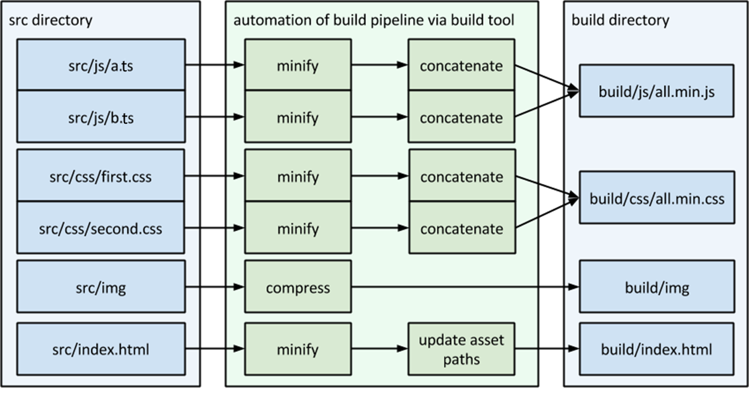
Build process What does this come down to
Organize your files
Minify
Concat
Debug Typescript Sourcemaps
Running Tests
Code styles
Reload website on change And much much more

Slide 32





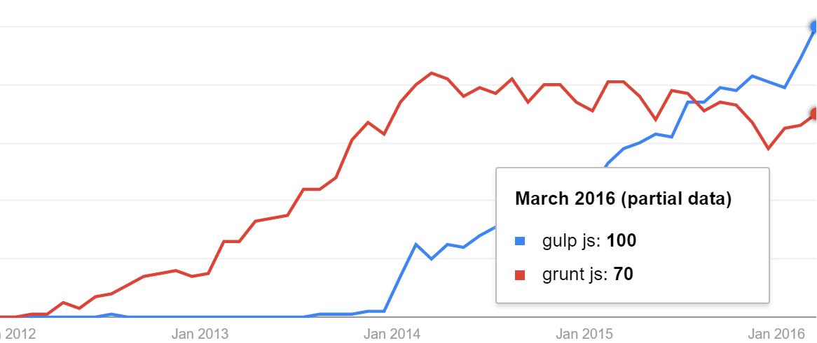
Build process Grunt vs Gulp
 | Grunt | Gulp
Plugins | 5500 results for ‘grunt’ | 2200 results for ‘gulp’
Method | File copy | Stream
 | Configure | Code

Slide 33
Build process Gulp
1 file
5 functions
Runs in Nodejs
Installed using NPM
gulpfile.js in de project root
Task
Src
Pipe
Dest
Watch

Slide 34
Build process Gulp - task
/**
* Copy and concat libraries
* @return {Stream}
*/ gulp.task('build-libs', function () { });

Slide 35

Build process gulp - src
/**
* Copy and concat libraries
* @return {Stream}
*/ gulp.task('build-libs', function (done) {
return gulp.src('libs/**/*.js')
});
* wildcard

Slide 36
Build process Gulp - pipe
var concat = require('gulp-concat');
/**
* Copy and concat libraries
* @return {Stream}
*/ gulp.task('build-libs', function (done) {
return gulp.src('libs/**/*.js ')
.pipe(concat('libs.js'))
});
Use plugins to modify the files in the stream

Slide 37
Build process Gulp - Dest
var concat = require('gulp-concat');
/**
* Copy and concat libraries
* @return {Stream}
*/ gulp.task('build-libs', function () {
return gulp.src('libs/**/*.js ')
.pipe(concat('libs.js'))
.pipe(gulp.dest('/build'))
});
Writes the files in de stream to a destination

Slide 38
Build process Gulp - Watch
/**
* watches for changes and rebuilds sepecific parts
* @return {Stream}
*/
gulp.task('watch-libs',['build-libs'], function () {
gulp.watch('libs/**/*.js ', ['build-libs']);
});
Watches a glob pattern and runs a task if there are changes

Slide 39
Managing packages/ Build process Bower/Gulp – Demo
Notes:
Geintereerd met Visual studio

Slide 40
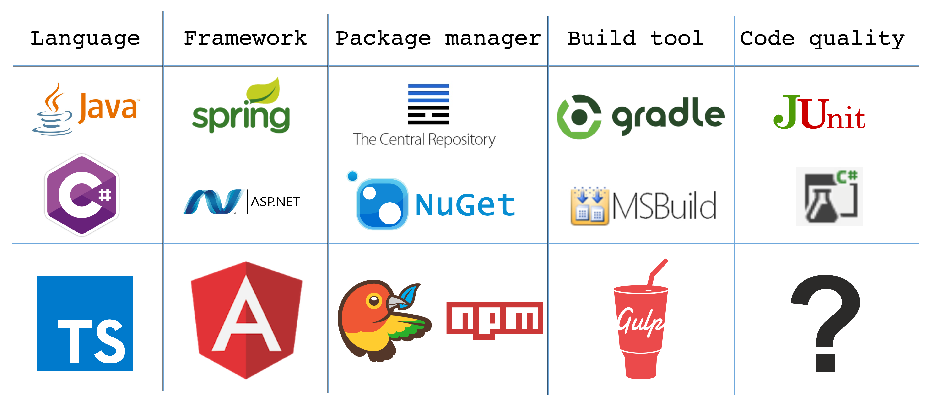

Slide 41



Code Quality Unit testing
Front-end code more and more business logic
Mobile apps written in javascript
Frameworks
Test runner: Karma
Testing framework: Jasmine
Mocking framework: Angular mock

Slide 42




Code Quality Unit testing - Karma
Run your tests automated.
Almost any browser.
Can be started from Gulp

Slide 43
Code Quality Unit testing – Jasmine
BDD Behavior Driven Development
describe
beforeEach
it
expect
describe("talkController", () => {
let controller;
beforeEach(() => {
controller = new Talk.TalkController();
});
it("should toggle the variable", () => {
controller.toggle();
expect(controller.toggle).toBeFalsy();
});

Slide 44
Code Quality Unit testing – Mocking angular
beforeEach(angular.mock.module("talk"));
let talkService: Talk.ITalkService;
let $httpBackend: angular.IHttpBackendService;
beforeEach(angular.mock.inject((_talkService_, _$httpBackend_) => {
talkService = _talkService_;
$httpBackend = _$httpBackend_;
}));
$httpBackend.when ("GET", urlConfig + "talks").respond(500);
console.log(angular.mock.dump(talkService));
3 public functions:
Load modules
Get Mocked angular components
Output debug information

Slide 45
Code Quality Style checking
jSLint
tSLint
Code guidelines for your team

Slide 46
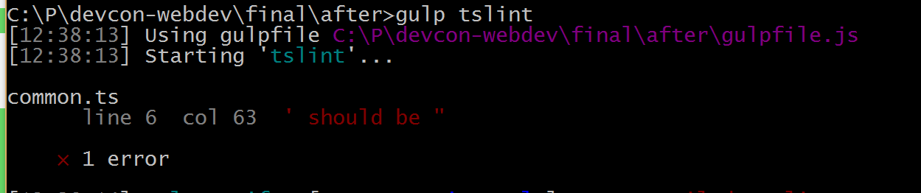
Code Quality Style checking
{
"rules": {
"quotemark": [ true, "double", "avoid-escape" ]
}
}
namespace Common {
const name = "devcon-webdev";
let app: angular.IModule = angular.module(name, ['templates', "ui.router", "people"]);
}

Slide 47
Code Quality Testing\Lint – Demo

Slide 48
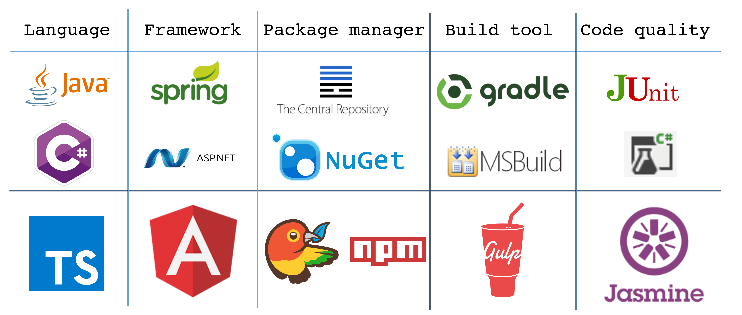
Code Quality Unit testing – Jasmine
BDD Behavior Driven Development
describe
beforeEach
it
expect

Slide 49

Thank you
Available for questions in the Q&A room
Github: http://lumin.is/webdev

